Slide 1
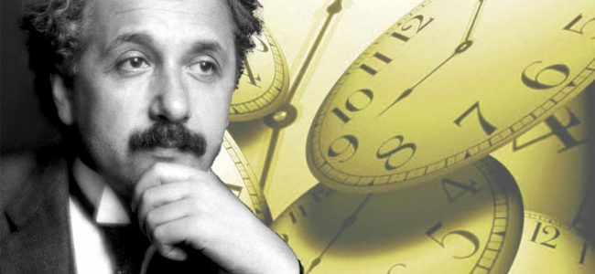

Slide 2
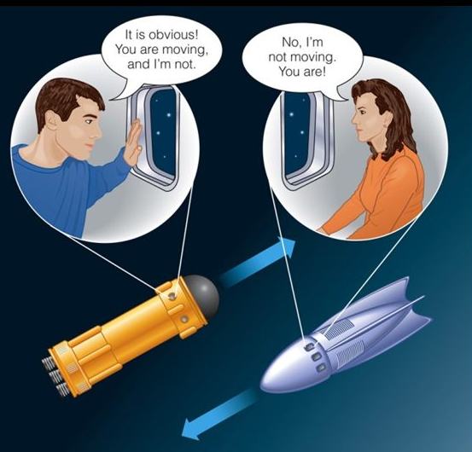

Slide 3
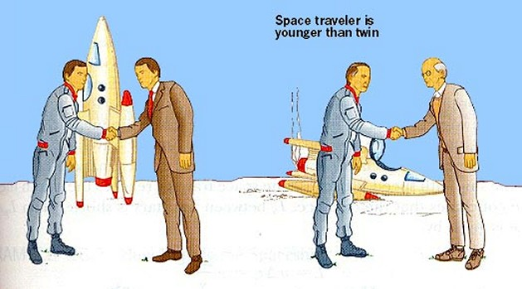
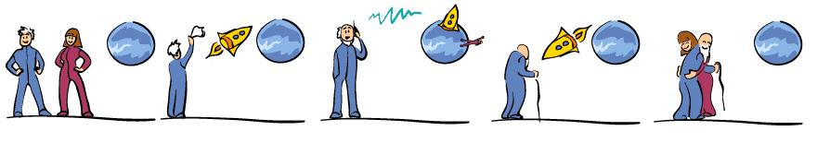
space traveller is younger when they return

Slide 4

v = 0
v = 0.87c
v = 0.995c
v = 0.999c
v = c (?)

Slide 5
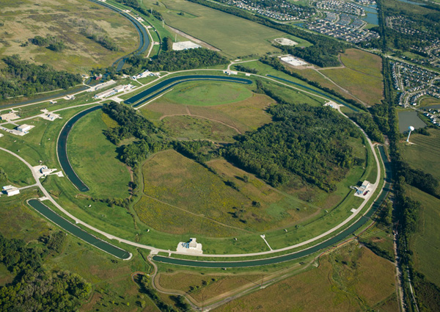
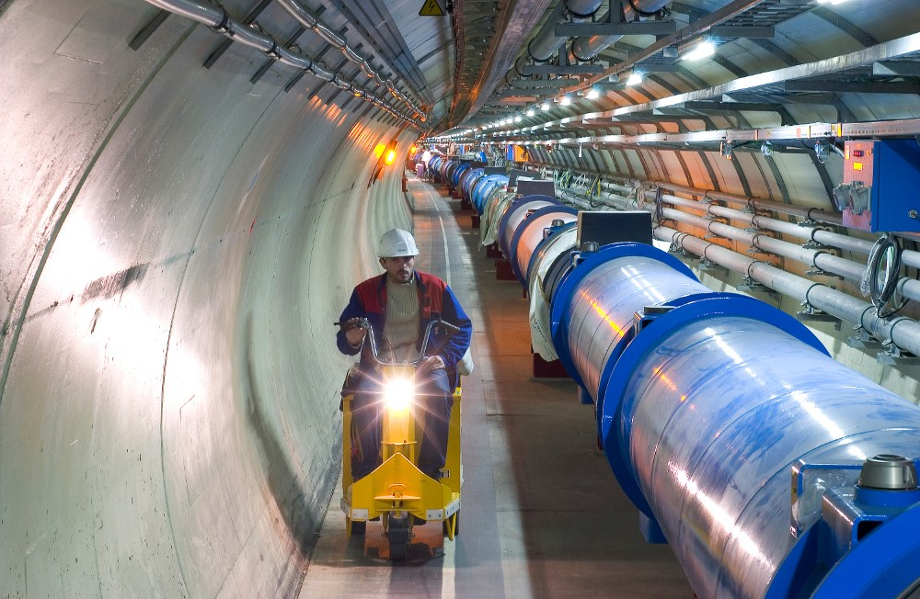

Slide 6
Cart moves with a constant velocity
Ball is throw vertical up by Mary in the cart
Mary states the ball travels in a straight line – it goes up then down
Steve states the ball travels along a parabolic arc

Slide 7
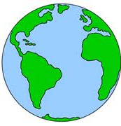
day
night
Sun

Slide 8
left
right

Slide 9
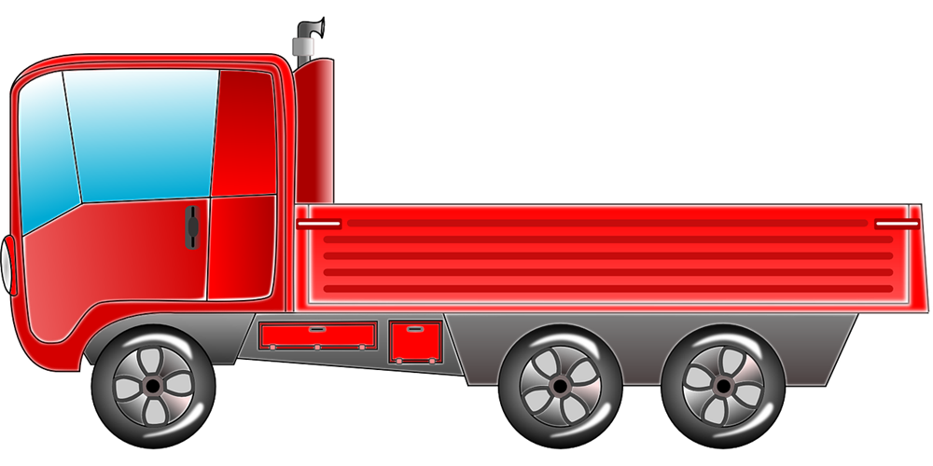

inertial frame of reference
Mary
v = 20 km.h⁻¹
inertial frame of reference
Steve
v = 180 km.h⁻¹
non-inertial frame of reference
Eve

Slide 10
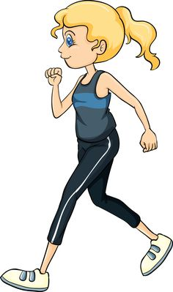
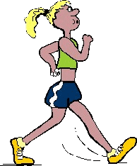
light beam
speed c
Mary
Eve
v
v
walking speed v
speed of light w.r.t to Mary
c + v
speed of light w.r.t to Eve
c - v

Slide 11

ether
(absolute frame of reference)
speed of Earth w.r.t. ether v
light beam
c w.r.t ether
light beam
c w.r.t ether
v
speed of light w.r.t. Earth
c - v
speed of light w.r.t. Earth
c + v

Slide 12

Mary’s inertial frame of reference (Mary’s moving system)
Y_{M}
t₀
X_{M}
v
v
detector switched on
light globe switched on
Event: time for light to travel from globe to activate light detector
Y_{S}
X_{S}
t
Steve’s inertial frame of reference
(Steve’s fixed system)

Slide 13
velocity of Mary
wrt Steve
Y_{M}
X_{M}
y_{M} = 10 m
c = 3.00x10⁸ m.s⁻¹
v = 0.8c
Y_{S}
X_{S}

Slide 14
Pythagoras

Slide 16
Mary’s system
Steve’s system

Slide 17
Mary
Y₁
Steve
X₁
Y_{S}
X_{S}
Eve
Y₂
X₂
moving system
fixed systems

Slide 18
Mary
Y₁
Steve
X₁
Y_{S}
X_{S}
Eve
Y₂
X₂
moving system
fixed systems

Slide 19
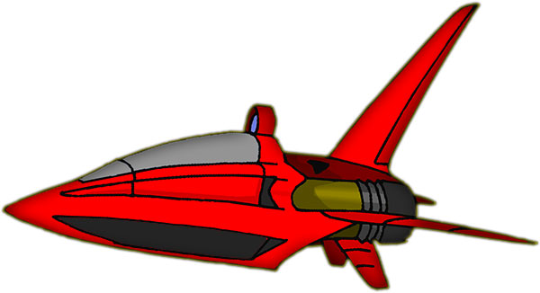
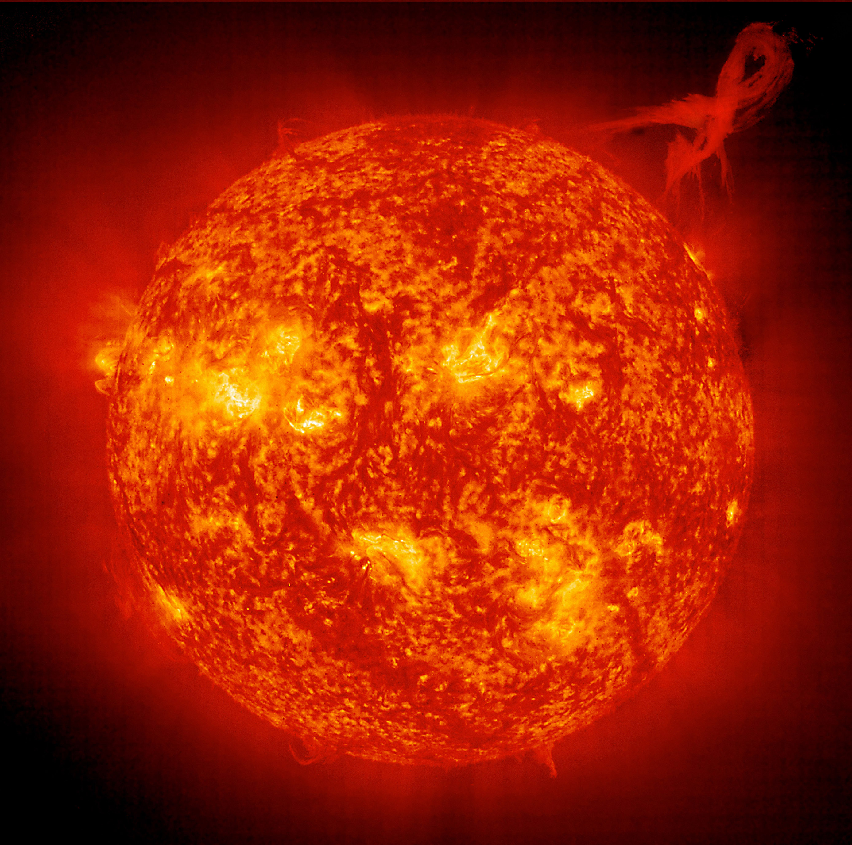
Mary
moving frame
Y_{M}
X_{M}
Earth
Vega
Steve
fixed frame
Y_{S}
X_{S}

Slide 20
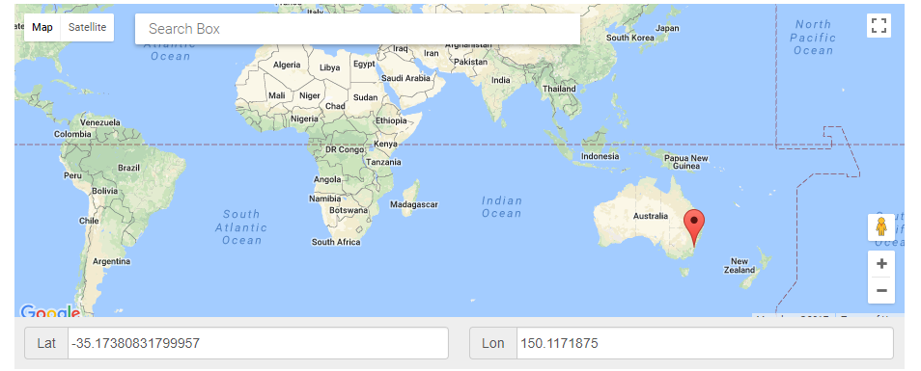
latitude
longitude

Slide 21
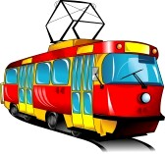
train at rest w.r.t. observer
train in motion w.r.t. observer
train is shorter in direction in motion but just as high and wide as it was at rest

Slide 22
Stationary frame
t₁
t₂
Earth observer: time interval t for spacecraft travelling at speed v to travel a distance L₀ to red planet
Moving frame
Spaceship observer: time interval t₀ for spacecraft to travel the distance L to red planet which approaches at speed v

Slide 23
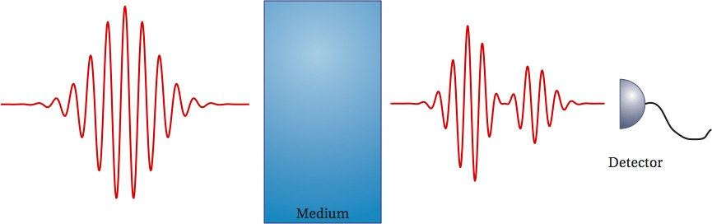
Mary

Slide 24
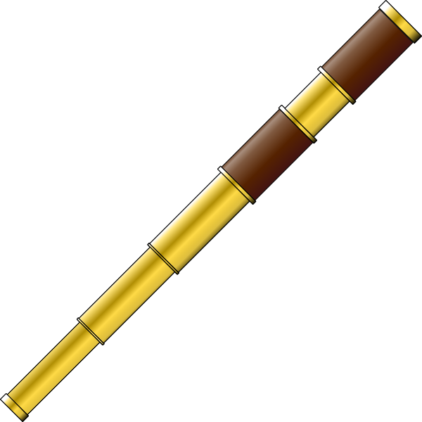
Mary
Steve

Slide 25
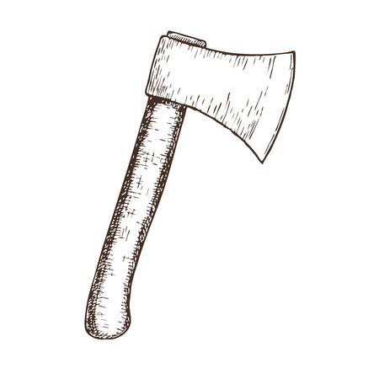
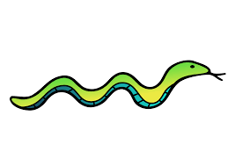
Stationary frame: Steve’s observation
proper length of snake
1.00 m
t = 0
t = 0
v = 0.60 c
0.080 m
contracted length of snake moving at 0.600 c
Moving frame: Snake’s observation “I will be cut into two”: incorrect conclusion
proper length of snake
1.00 m
contracted length between knives moving at 0.600 c
v = 0.60 c
0.080 m
t = 0
t = 0
Using the concepts of special relativity, the snake will not see the knives drop simultaneously and the will not be cut into two pieces.

Slide 26
Moving frame of snake (Mary)
t_{M} = 0
x_{M} = 0

Slide 27

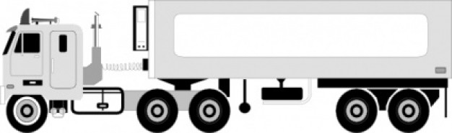
Rocket
Mary
Truck
Rocket
Truck
Rocket
Mary

Slide 29
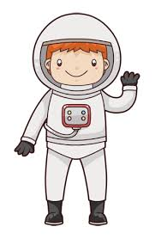



Steve
Mary
Rocket
Steve

Slide 30
Newtonian velocity addition
1.25 c
1.00 c
speed v
0.75 c
0.50 c
Relativistic velocity addition
0.25 c
0
0
10
20
30
rocket firings

Slide 31
Relativistic
momentum p
Newtonian
0
0
0.25c
0.50c
0.75c
1.00c
speed v

Slide 32
Stationary frame
m
Y_{S}
X_{S}
velocity is measured w.r.t stationary frame
total energy
momentum

Slide 33
mass neutron
energy input to disrupt nucleus
mass proton
mass deuterium nucleus
Conservation of mass energy
Mass defect
The mass of the bound state (deuterium nucleus) is less than combined masses of the proton and neutron.
Binding energy

Slide 34
deuteron
bound system: proton + neutron
free particle
proton neutron
?

Slide 35
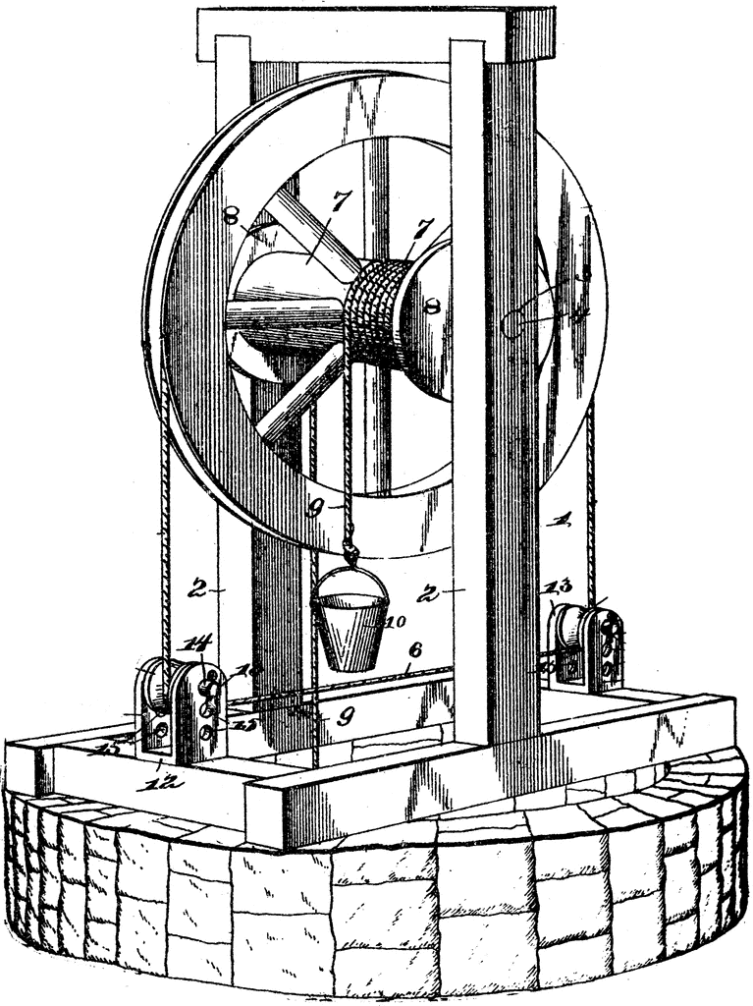
Potential energy function U for proton in potential well due to the strong nuclear attractive force of the proton to the neutron
U [MeV]
An external force does work to increase the potential energy of the system to lift water out of the well.
E_{B} = 2.22 MeV
0
- 2.22
~10⁻¹⁵ m
An external force does work to increase the potential energy of the system to separate the proton from the neutron. The energy required is the binding energy
E_{B} = 2.2 MeV

Slide 36
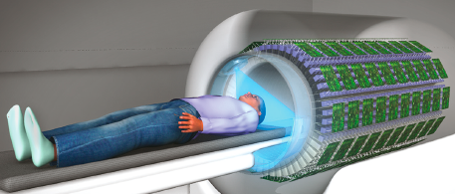
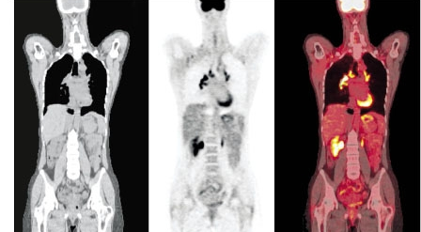
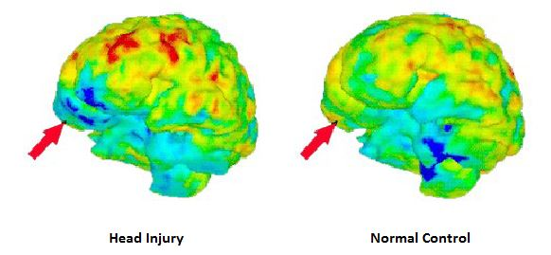
PET / CT scan
location of high cell activity
CT scan
organs & bones
PET scan
cell activity
normal
head injury

Slide 37
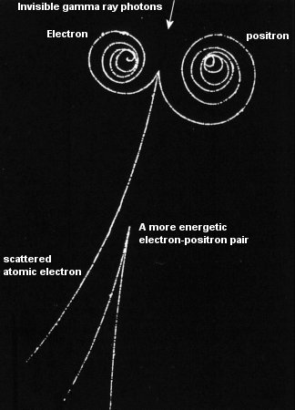
gamma ray
electron
positron
gamma ray
scattered electron
energetic electron-positron pair
positron
electron

Slide 38
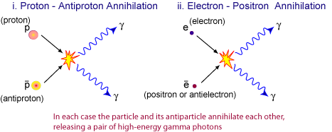
e+
positron
e-
electron

Slide 39

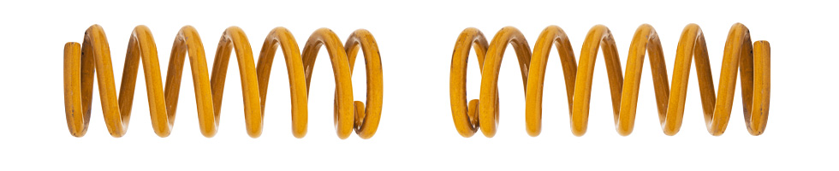
Work is done by the hands on the spring to compress it and increase its potential energy and hence the mass of the spring is also increased.

Slide 40
v
v
A
B
m
m
m
m

Slide 41
charge, momentum & energy conserved
Initial state
reactants
Final state
products
rest energies
potential
energies
rest energies
kinetic
energies
kinetic
energies
external energy
input
potential
energies

Slide 42
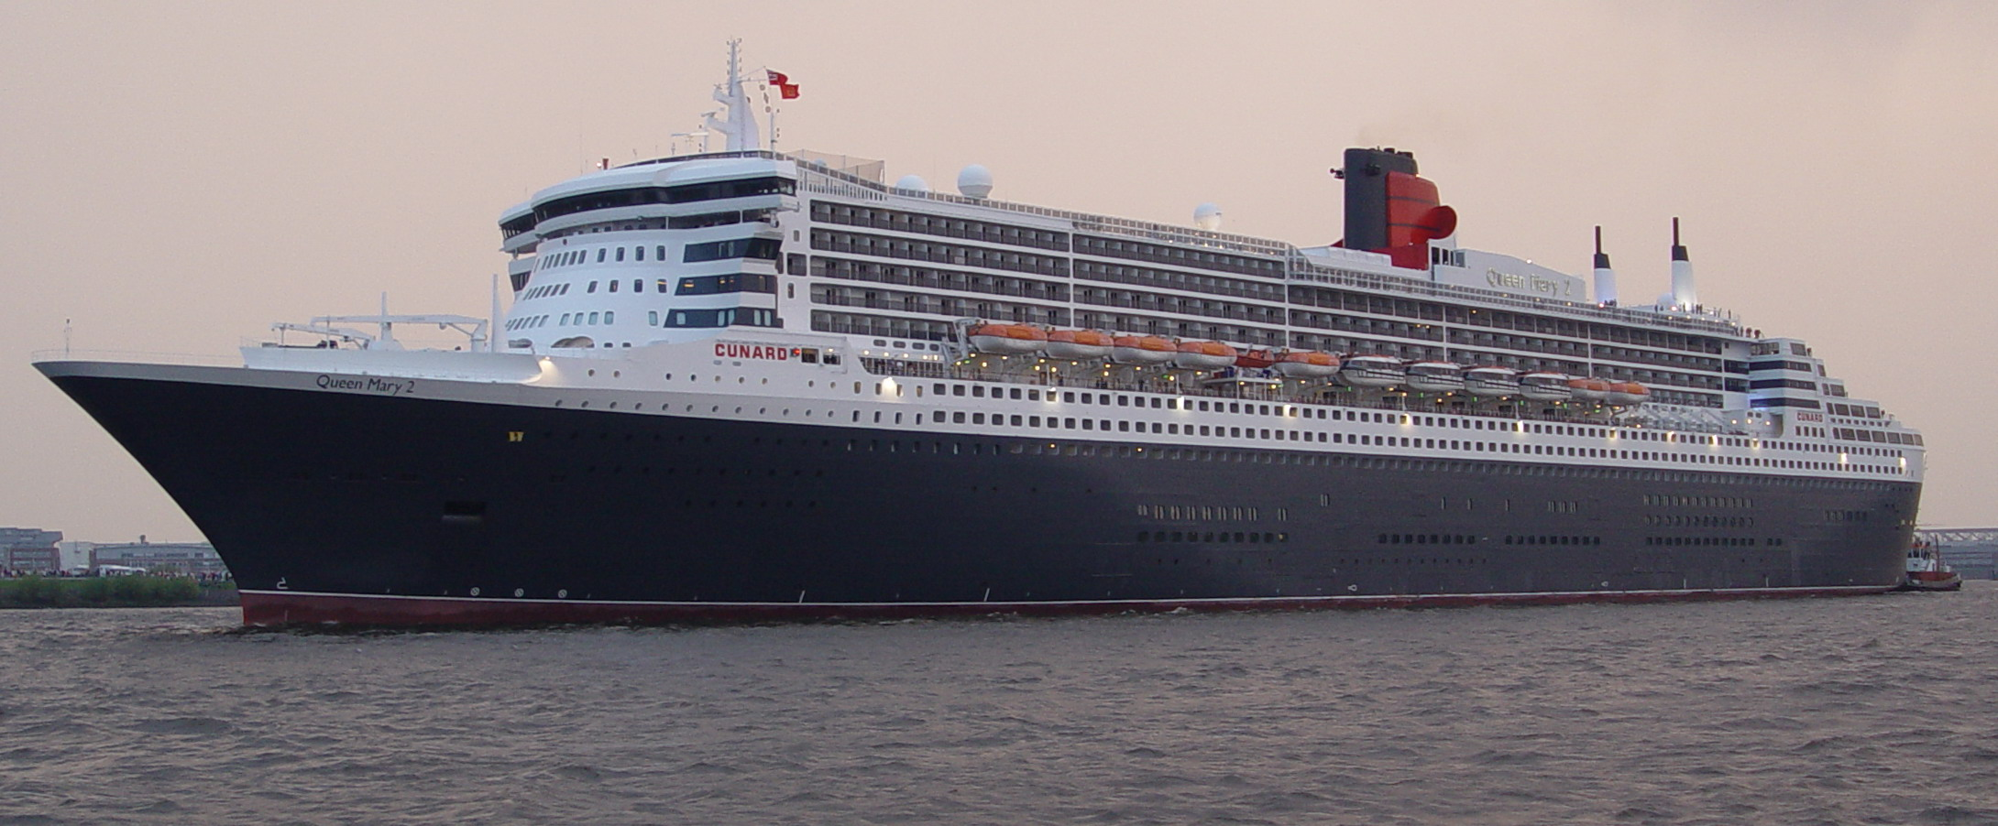
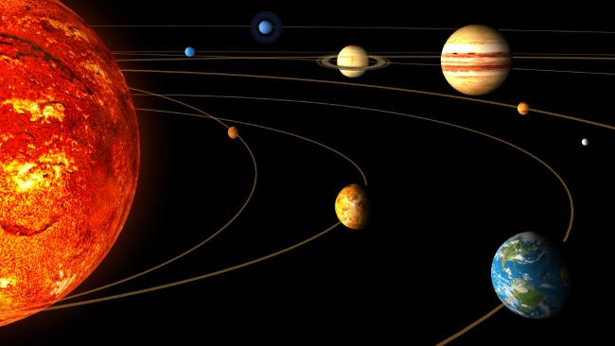
Queen Mary’s mass is 1.5x10⁸ kg

Slide 43
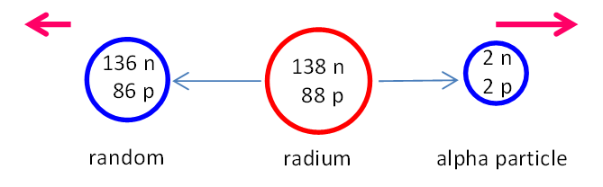
radon

Slide 44
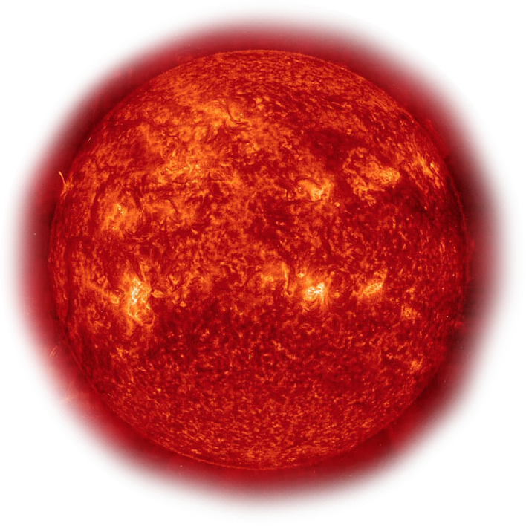
The source of energy of a star is due to fusion reactions.
As the star radiates energy, the mass of the star decreases.

Slide 45
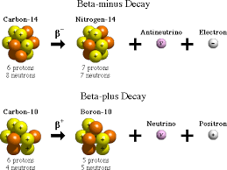
carbon 14
nitrogen 14
electron
antineutrino
6 protons
8 neutrons
6 protons
8 neutrons
7 protons
7 neutrons
carbon 10
boron 10
positron
neutrino
+
6 protons
4 neutrons
5 protons
5 neutrons
Electron capture
neutrino
+

Slide 46
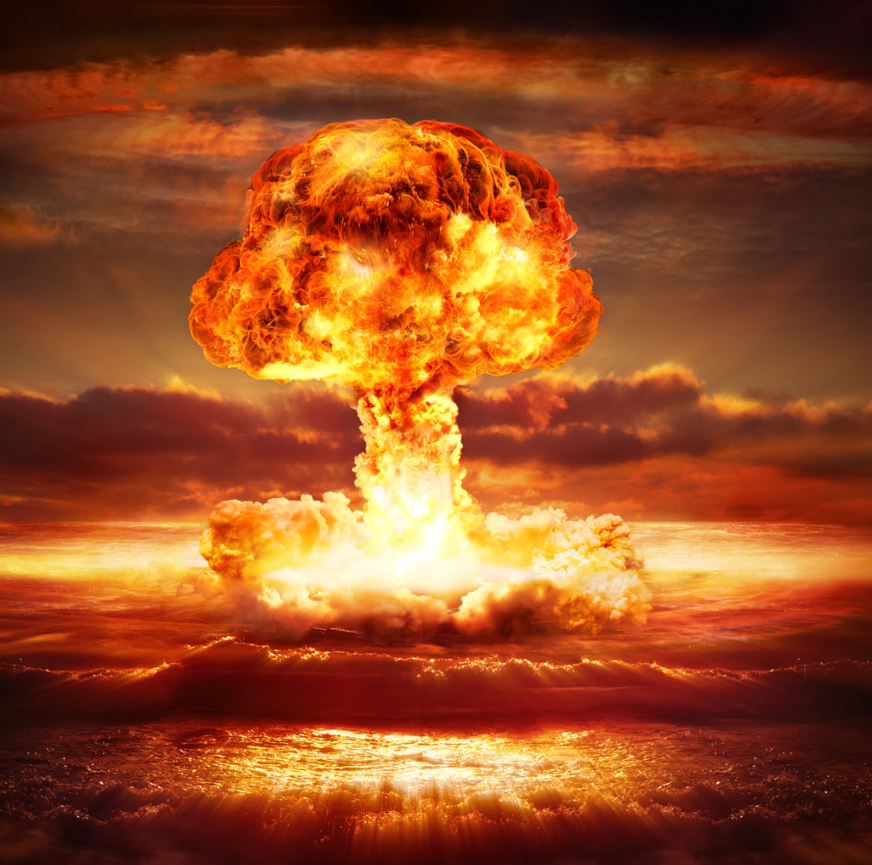
The source of energy in an atomic bomb explosion comes from the loss of mass associated with the binding energies of the constituents of the nuclei. The binding energy is transformed into electromagnetic radiation and the kinetic energy of the fragments after the explosion.

Slide 47
KE < 0.22 MeV
KE < 0.22 MeV
KE > 0.22 MeV
KE > 0.22 MeV
+
+
+
+
FUSION
+
+
+
+
repulsive Coulomb force
~10⁻¹⁵ m
+
+
+
+
Coulomb repulsive force prevents nuclei getting close enough together for fusion
time

Slide 48
proton
neutron
P
N
deuteron
P N

Slide 49
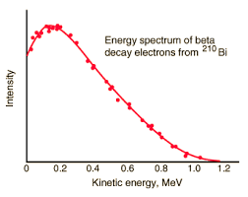
Energy spectrum bismuth 210
bismuth → polonium
beta particles detected
beta particle kinetic energy [MeV]

Slide 50
proton
neutron
deuteron
P
N
P
N
Conservation of mass-energy

Slide 51

muon system
proper time
1000
2000 m
v = 0.98c
540
dilated time
Earth system

Slide 52

L = 1.5x10⁴ m
v = 0.98 c
v = 0
t₀ = 2.2 μs

Slide 53
h = 1.0x10⁴ m
muon created
L = ? m
v = 0.98 c
muon decayed

Slide 54
h = 1.0x10⁴ m
muon created
v = 0.98 c
muon decayed
dilated time interval
average distance travelled by muon

Slide 55
h = 1.0x10⁴ m
muon created
L = ? m
muon decayed
v = 0.98 c
proper length
contracted length observed in Muon frame

Slide 56
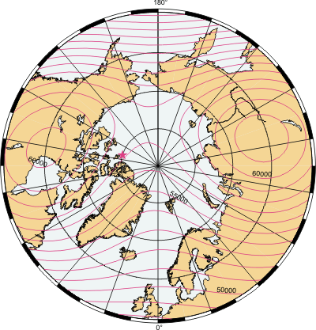
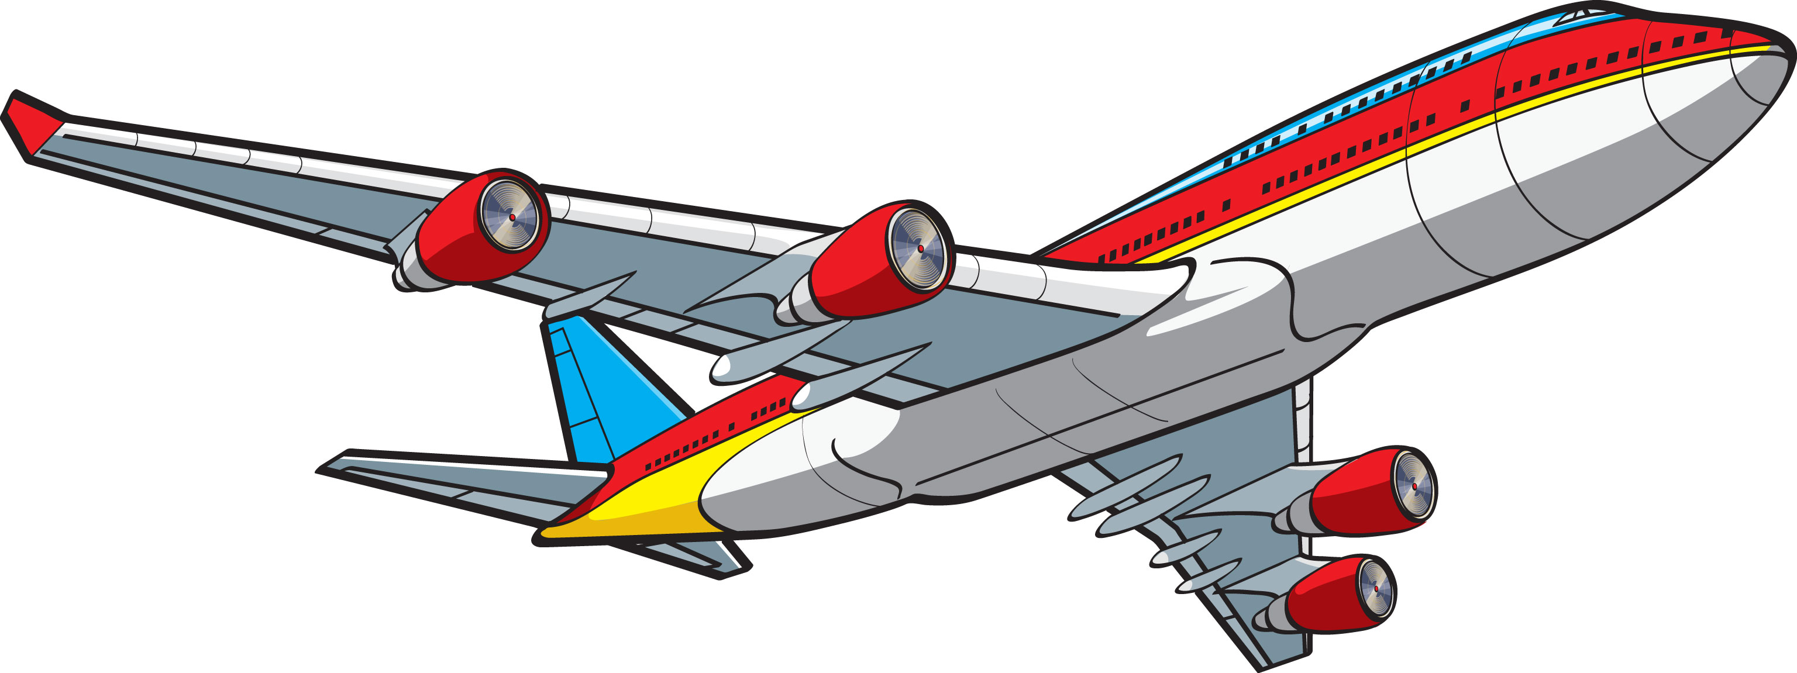
Washington D.C.
Earth’s
rotation
N
eastward
westward

Slide 57
Mary
moving frame
Y_{M}
X_{M}
Steve
fixed frame
Y_{S}
X_{S}

Slide 58
redshifted reflected light
VENUS
incident light
rotation
blueshifted reflected light

Slide 59
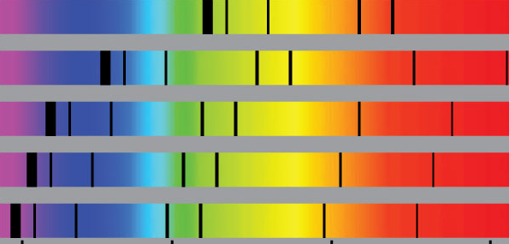
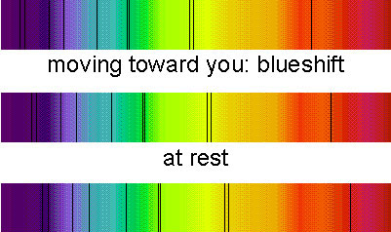
very distance galaxy
distance galaxy
nearby galaxy
near by star
lab reference
400
500
600
700
wavelength
blueshift (moving toward you)
stationary
redshift (moving away you)

Slide 60
K_{He}
K_{Ra}

Slide 61


Slide 62


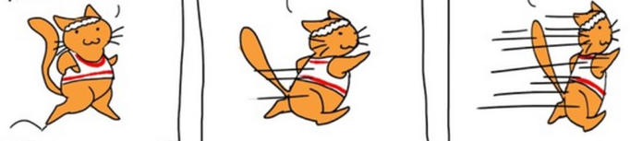
running is a very good experience for keeping in shape
as relativity says, the faster you go …
… the thinner you get !!!

